Slide 1
Digital Trail Chasing
Using Open Source Intelligence techniques to find out how much information is public about you and your friends
@spyblog CryptoParty London 25 Jan 2018

Slide 2
Why survey your own data ?
You cannot use many of the techniques demonstrated at a CryptoParty without first having a good idea of what information about yourself and those close to you might have to protect.
There will be some public information you cannot do much about, without drastic lifestyle action
It is often surprising that lots people’s personal information is *not* easily available online – yet.

Slide 3
Threat Actors
What sort of attacker is likely to get your personal data ?
High Skill, High Resources, Long Persistence
High Skill, Limited Resources, Limited Persistence
Low Skill, Limited Resources, Long Persistence
Low Skill, Limited Resources, Short Persistence, Luck
Resources = multiple people & infrastructure
Persistence = how long will a campaign last e.g. hours, days, weeks, months or years ?

Slide 4
High Skill, High Resource Threats
High Skill, High Resources / Budget, Long Persistence – months or years
Law Enforcement & Intelligence Agencies (UK & Foreign)
Only if you are seen as a major threat
N.B. Data from Short Persistence, untargeted / collateral “bulk data” scans / exploits likely stored “just in case”
Organised Criminal Gangs
Only if you are rich or are a vulnerable part of a crime plan e.g. Bank Manager, Systems Administrator

Slide 5
High Persistence Threats
Low Budget / resources but Long Persistence & maybe Luck
Funded Investigative Journalists
Hackers
Political Activists doing Opposition Research / digging up political dirt
Online Trolls / Stalkers / Abusive Ex-Partners
Terrorist & Paedophile “groomers” looking for vulnerable victims

Slide 6
Low Budget / Persistence Threats
Skilled attackers but time constrained due to deadlines or resource limits / finances:
Ex LEO / IA working as Private Investigators / Security / Risk / Due Diligence / High Profile Job Recruitment Consultants
Freelance Investigative Journalists
Tabloid Journalists & Paparazzi
Except for bankable Celebrities = Long Persistence

Slide 7
Resources
Hunted on Channel 4 tv - 9pm Thursdays i.e. tonight (hope my recorder is working)
http://www.channel4.com/programmes/hunted
The Glass Room – Data Detox
https://tacticaltech.org/news/data-detox-kit/
OSINT online tools (not all work on UK people)
https://start.me/p/ZGAzN7/verification-toolset
https://inteltechniques.com/menu.html
http://spiderfoot.net/download/
http://network-tools.com/ - Express option
https://shodan.io vulnerable Internet of Things et.
https://haveibeenpwned.com/ - check on email / hacked password reuse
#OSINT hashtag on Twitter
Google search, Maps, Street View & Bing Maps
Companies House
Estate Agents websites (for expensive properties) – photos & floorplans
“Free” tools often need ReCaptcha completion against scraper scripts

Slide 8
Resources
Electoral Roll – voter registration – opt out of public version (finance companies & MI5 still get this)
Have you or target stood for Council or MP etc. election – Home Addresses on Local Council websites of previous Elections
Estate Agents websites (for expensive properties i.e. almost all London ones) – photos & floorplans

Slide 9
Resources
Domain Names – current (free) – often need ReCaptcha completion against scraper scripts
https://who.is
https://ping.eu
http://network-tools.com
For .co.uk or .org.uk or .net.uk or .uk domain names you can Opt Out of the whois if you are *not* using it for trading

Slide 10
Don’t be stingy – not everything is free
Don’t be stingy – not everything is “free” – pay a bit of money if your privacy and security are important to you.
Domain names – historical
Domain Tools (£)
https://research.domaintools.com/research/whois-history/
.com .org .net etc. domain names cost extra with a whois privacy nominee options

Slide 11
Don’t be stingy – not everything is free
DVLA Registered keeper of a Vehicle
Often yields Home Address of Private Vehicles
otherwise Company Address / Leasing Company
https://www.gov.uk/request-information-from-dvla
£2.50 per vehicle plus “reasonable cause” e.g. involved in an accident, parking fine etc.

Slide 12
Don’t be stingy – not everything is free
Data Protection Act 1998
Subject Data Access Request
Currently max £10 fee (never any less !)
Supposed to reply within 40 days (i.e. usually after 30 day CCTV data retention)
Only info about yourself , not other people
Can include CCTV footage, emails, database records
Public bodies and Private companies including Mobile Phone networks itemised billing with some Location Data

Slide 13
Learn from Tabloid Celebrity Stalking
Just because The Sun and The Daily Mail have some toxic political views, does not mean that you cannot learn from their Stalking of Celebrities
James Stunt – billionaire Gold Bullion dealer currently going through alleged £5.5 billion divorce from Petra Ecclestone (daddy’s Formula 1 fortune)
http://www.dailymail.co.uk/news/article-5298027/Petra-Ecclestone-flanked-sister-Tamara-arrives-court.html

Slide 14
Learn from Tabloid Celebrity Stalking
James Stunt pictured arriving at Court with a Satellite Phone
Inmarsat
Sensational £90 million burglary claim
Pictures of assistants with bags (washing basket in Luis Vuitton bag)
Pictures of Lamborghini and Rolls Royce etc. luxury cars
https://www.thesun.co.uk/news/5388659/billionaire-playboy-james-stunt-victim-of-record-breaking-90m-burglary/
No actual Address published – some Mews house in Belgravia, London – but where exactly ?

Slide 15
Learn from Tabloid Celebrity Stalking

Slide 16
Learn from Tabloid Celebrity Stalking

Slide 17
Learn from Tabloid Celebrity Stalking

Slide 18
Learn from Tabloid Celebrity Stalking

Slide 19
Learn from Tabloid Celebrity Stalking

Slide 20
Learn from Tabloid Celebrity Stalking

Slide 21
Learn from Tabloid Celebrity Stalking

Slide 22
Learn from Tabloid Celebrity Stalking

Slide 23
Learn from Tabloid Celebrity Stalking
Typical Belgravia off white terrace / mews houses
Note the building at the end of the street i.e. a bend / corner.
Note the Parking street sign on right and the sign with the arrow on the left
Note the 6 showing on the column on the right

Slide 24
Learn from Tabloid Celebrity Stalking
Try Reverse Image Search
https://www.google.co.uk/searchbyimage/upload
and tin eye
https://tineye.com/
Nothing useful- just the original photo in The Sun
Google Maps and Street View allows you to “drive” around Belgravia
Aerial view lets you find the White painted Mews houses, on not too wide a road.

Slide 25
Learn from Tabloid Celebrity Stalking

Slide 26
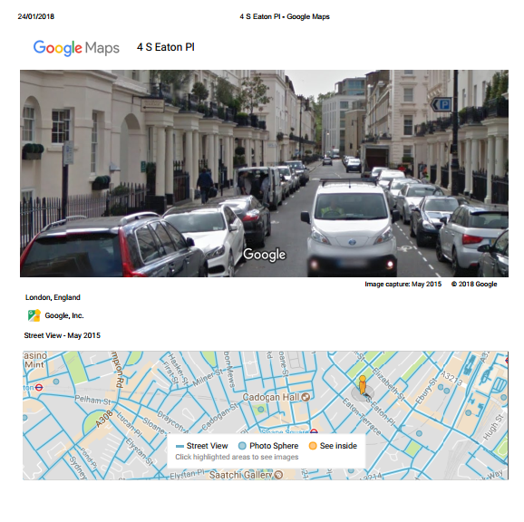
Learn from Tabloid Celebrity Stalking
4 South Eaton Place, Belgravia, London
https://goo.gl/maps/1hCiwYtNPfM2

Slide 27
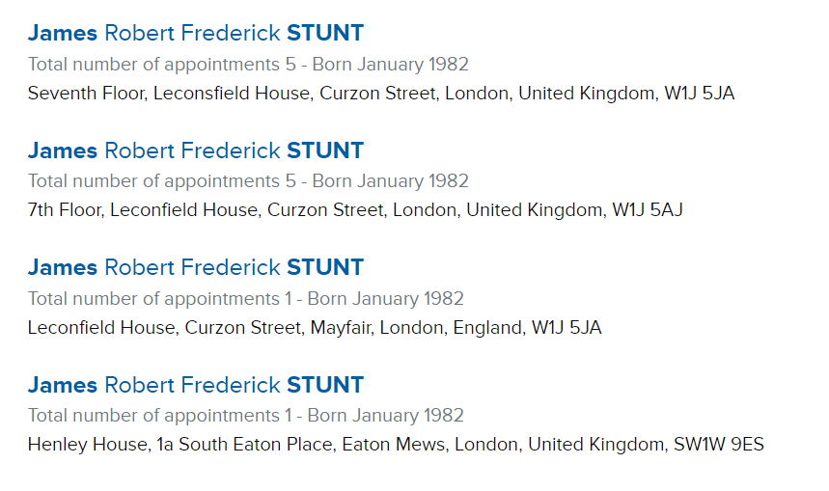
Learn from Tabloid Celebrity Stalking
Now try a Companies House search for “James Stunt” https://beta.companieshouse.gov.uk/

Slide 28
Learn from Tabloid Celebrity Stalking
Google search led to RightMove website with a listing and photos and plan of Henley House, 1a South Eaton Place
http://www.rightmove.co.uk/property-for-sale/property-46093549.html
Use Firefox i.e. Tor Browser - View Page Info / Media tab - rather than Chrome to grab the 15 individual images of the property

Slide 29
Learn from Tabloid Celebrity Stalking

Slide 30
Learn from Tabloid Celebrity Stalking

Slide 31
Learn from Tabloid Celebrity Stalking

Slide 32
Learn from Tabloid Celebrity Stalking

Slide 33
Learn from Tabloid Celebrity Stalking

Slide 34
Learn from Tabloid Celebrity Stalking

Slide 35
Learn from Tabloid Celebrity Stalking

Slide 36
Learn from Tabloid Celebrity Stalking

Slide 37
Learn from Tabloid Celebrity Stalking

